Slide 1
Data Engineering Brown Bag Session #1
A guide by Gab

Slide 2

Data Engineering
Creating pipelines to deliver the data an organization needs from various sources to just one source.
Cleaning data to be usable for analysis, models, and other applications.

Slide 3
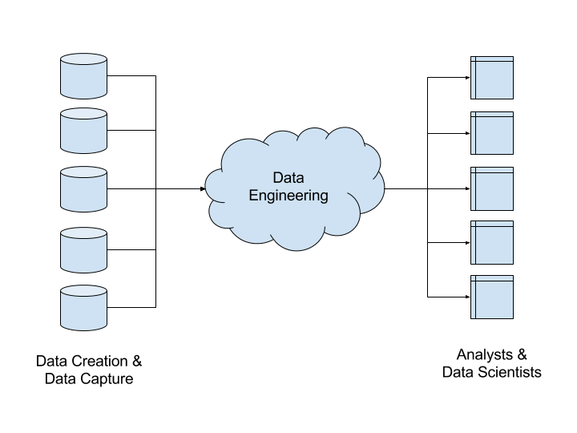

Slide 4
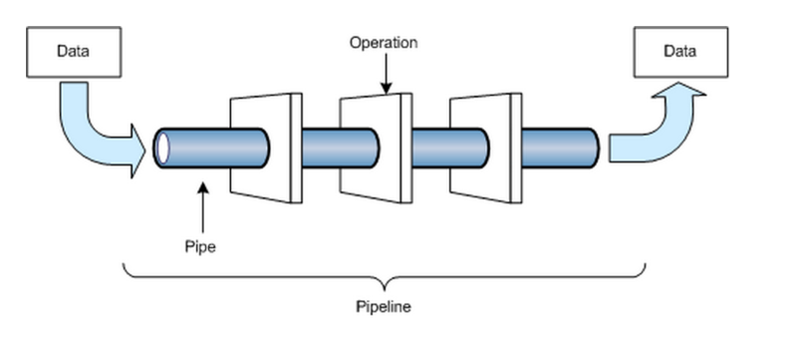

Slide 5


Tools Used
SQL For manipulating local or cloud environments storing the data
ETL Tools Making pipelines easier with minimal coding.
Python / R For hands on processing of the data and generating pipelines
Big Data Tools For processing significantly large amounts of data.

Slide 6
Types of Data Engineering
SQL Focused, supplemented by ETL tools (Data Warehouse)
Local Environment
Cloud Environment
Big Data Focused, dealing with significantly large amounts of data (Data Lakes)
Mostly ELT and raw data

Slide 7
Types of Data Engineering
SQL Focused, supplemented by ETL tools (Data Warehouse)
Local Environment
Cloud Environment
Big Data Focused, dealing with significantly large amounts of data (Data Lakes)
Mostly ELT and raw data

Slide 8
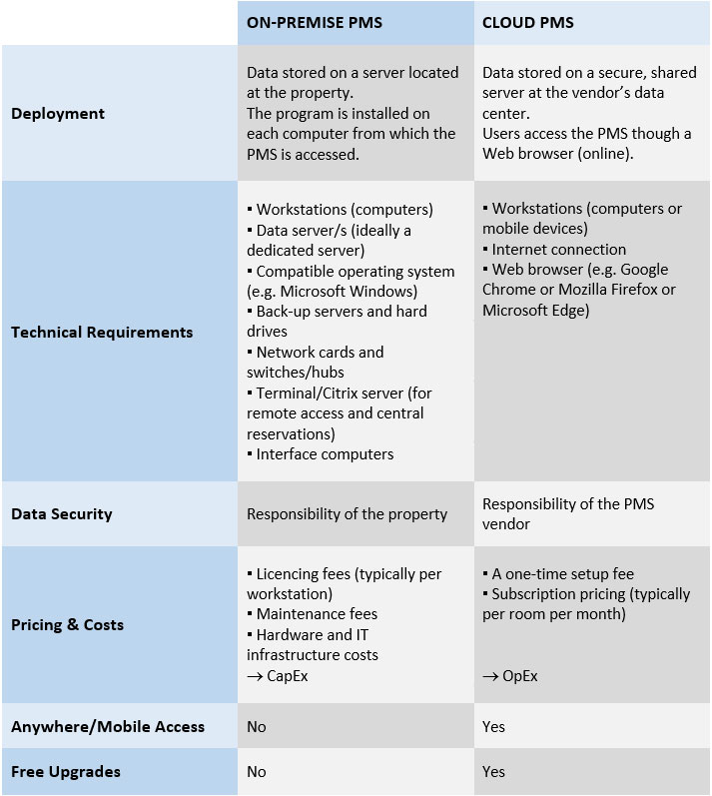

Local DB or
Cloud?

Slide 9
Data Engineering.
Local Environment.

Slide 10



Tools
XAMPP
MySQL
Pentaho
Runs a local server
And MySQL for dev.
DB Environment we’ll use for the exercise
Open source ETL tool

Slide 11
We’ll Tackle the Following:
Reading DB Entity Relationship Diagrams
Data Engineering with SQL
(Best Practices)
Using Pentaho for ETL
Normalization

Slide 12

HANDS ON ACTIVITY #1

Slide 13

Client
Seller of classic and vintage cars and motorbikes

Slide 14
Client - Problem
The report they have are currently use is manually computed through pivot tables on excel.
They want to automate the process to reduce the time for reports preparation.
They are also looking into integrating their data to BI Tools

Slide 15
Client - What We’ll Need
Expected Output / Sample Data
Identify the sources of data
Get the Entity Relationship Diagram of their database
Get the Data Dictionary

Slide 16
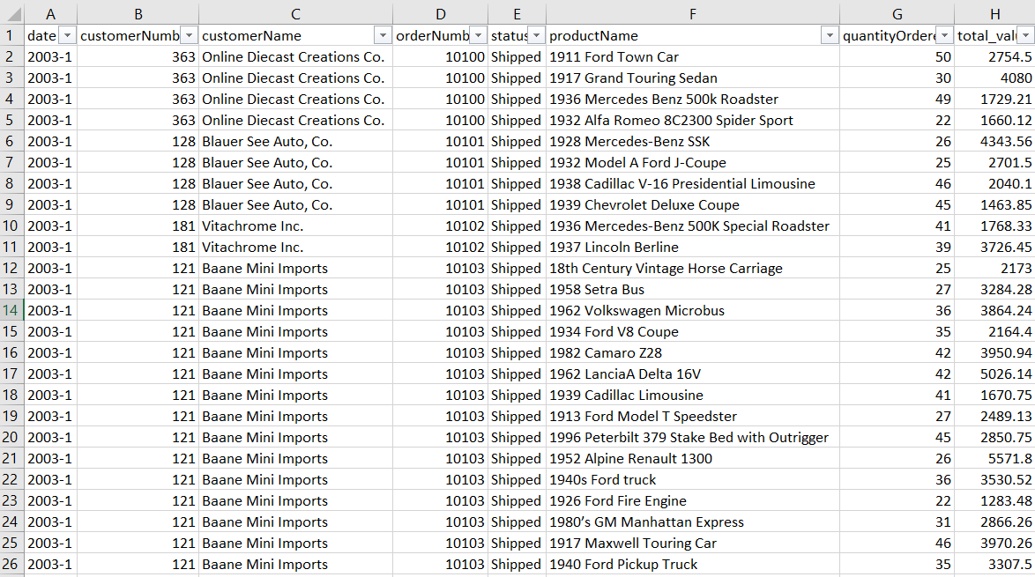
Sample Output - Monthly Transactions Report

Slide 17
Sample Output - Monthly Transactions Report
Columns Needed
Date
Customer Number
Customer name
Order Number
Status
Product Name
Quantity Ordered
Total Value

Slide 18
2. ERD - What is an ERD?
An Entity Relationship Diagram (ERD) is a snapshot of data structures.
An Entity Relationship Diagram shows entities (tables) in a database and relationships between tables within that database.

Slide 19
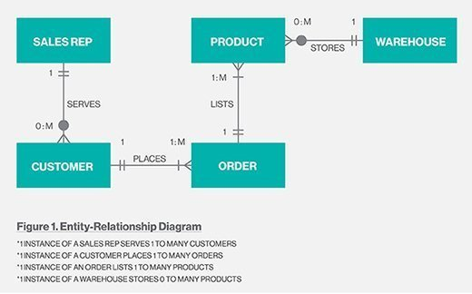
2. ERD - Reading ERDs

Slide 20
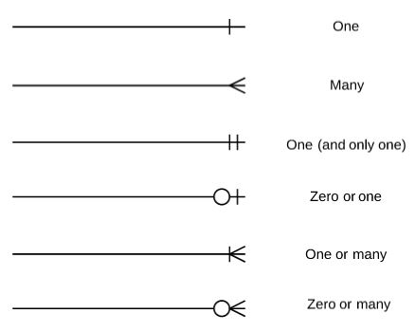
2. ERD - Reading ERDs

Slide 21
2. ERD - Reading ERDs

Slide 22
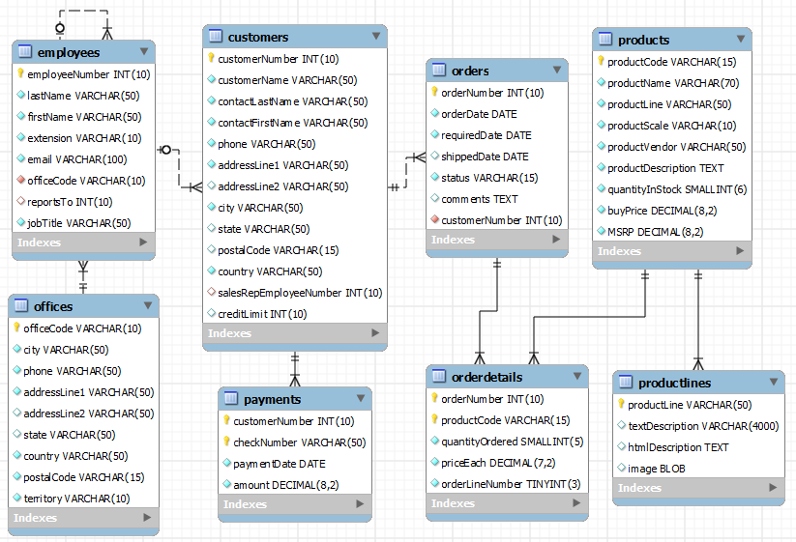
2. ERD - Classic Models ERD

Slide 23
2. ERD - Classic Models ERD
Columns Needed
Date
Customer Number
Customer name
Order Number
Status
Product Name
Quantity Ordered
Total Value

Slide 24
2. ERD - Classic Models ERD
Columns Needed
Date
Customer Number
Customer name
Order Number
Status
Product Name
Quantity Ordered
Total Value

Slide 25
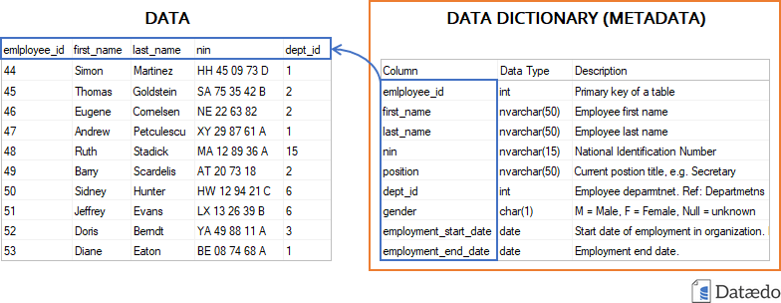
3. Data Dictionary - Sample

Slide 26
HANDS ON ACTIVITY #1 Data Engineering with SQL
Open SQL Codes/HOA#1 Folder and start from Query #1

Slide 27
HANDS ON ACTIVITY #2 Making Pipelines with Pentaho

Slide 28

Intro to Database Normalization

Slide 29
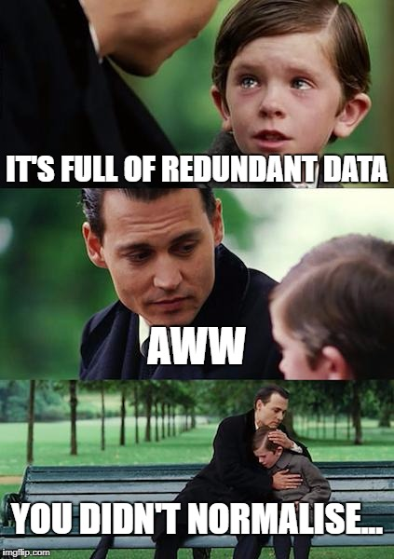
Normalization
A database design practice that reduces redundant data in relational databases.
Basically splitting up large tables into smaller tables

Slide 30
Normalization Pros and Cons
Pros
Updating and Inserting data is faster
Tables are smaller so memory space is minimal
Data integrity and consistency
Cons
Joins is required, making queries more complicated
Slower and lots of processing
Difficult and expensive to do

Slide 31
Quickie:
Data Warehouse vs Data Lakes
Data Warehouse
ETL
Clean / Transformed data
Transactions / Scheduled inputs
Mainly for transactional data (Sales, inventory,
Business Intelligence / Reports
Data Lakes
ELT
Purely raw data
Large amounts of inputs per second.
Mainly for analysis
Data Analytics and Science

Slide 32
Normalization Forms

Slide 33
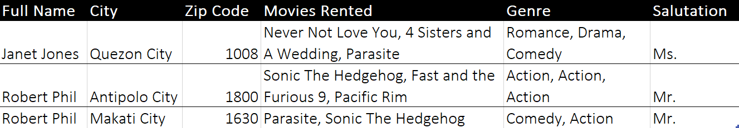
Unnormalized Form

Slide 34
1st Normal Form
Every attribute in every row should be a single atomic value
Each row should be unique

Slide 35
Unnormalized Form

Slide 36
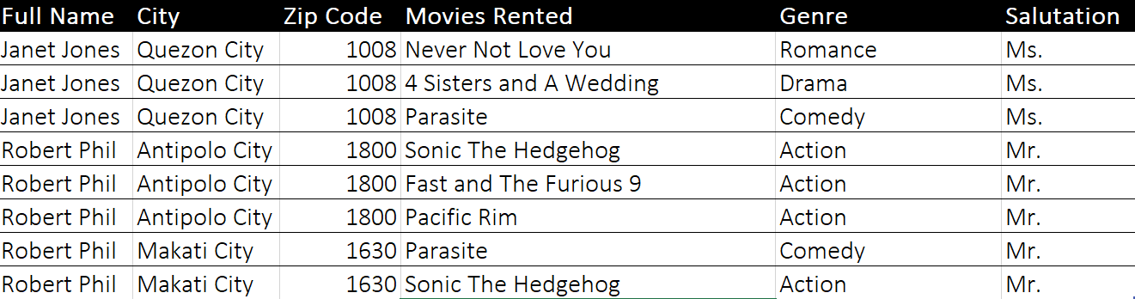
1st Normal Form

Slide 37
2nd Normal Form
The table must be in 1st normal form
Every composite keys must be dependent on a primary key
Composite keys are a group of keys that can uniquely identify a row together

Slide 38
1st Normal Form
Movie Rents

Slide 39
1st Normal Form
Movie Rents

Slide 40
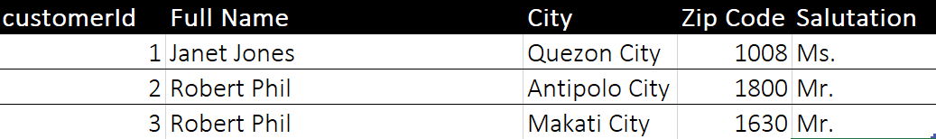
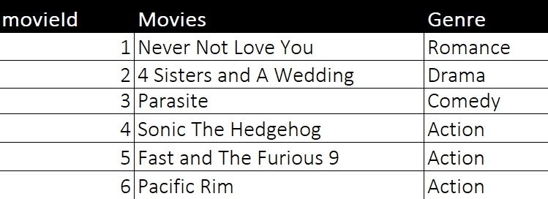
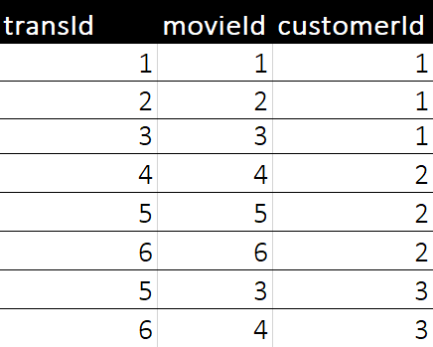
2nd Normal Form
Customers
Movies
Movie Rents

Slide 41
3rd Normal Form
The table must be in 2nd normal form
Has no transitive functional dependencies
X -> Z is a transitive dependency if the following three functional dependencies hold true:
X->Y
Y does not ->X
Y->Z

Slide 42
2nd Normal Form
Customers
Movies
Movie Rents

Slide 43
2nd Normal Form
Dependent
Customers
Movies
Movie Rents

Slide 44
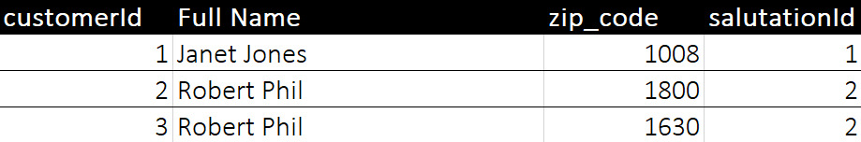
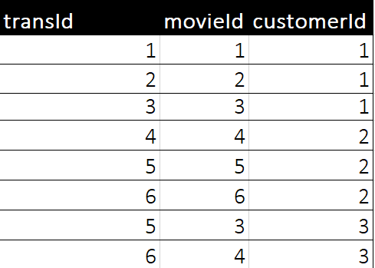
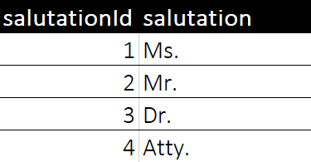
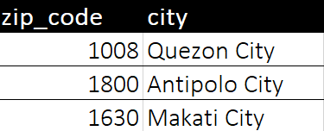
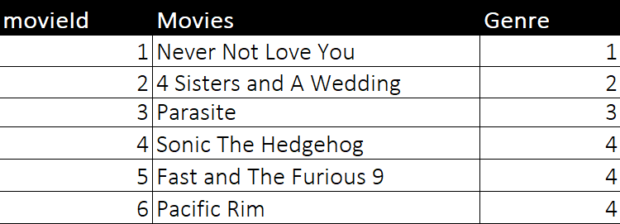
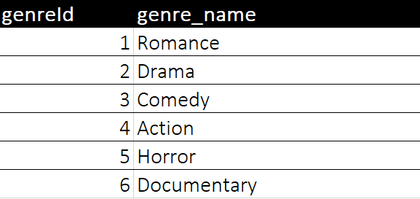
3rd Normal Form

Slide 45

Session Complete
Homework to be posted on Saturday

